Slide 1
Capstone project proposal: EM parameterization of CF composite
Sponsor: Tangitek LLC
Advisor: Branjmir Pejcinovic
Students: Ha Tran, Thanh Le, Jeffrey Brown

Slide 2
Requirements From Project Description
From 300 MHz to 30 GHz
EM parameter extraction:
Dielectric constant
Complex electric permittivity
Complex magnetic permeability
Loss tangent
Layer thickness
Simulation model for validation
NRL arch measurement

Slide 3
Project Management
Trello, GitHub, Gantt Chart
Project main phases:
Project Initialization: Research for approaches of material characterization
Prototype: NRL arch and waveguide with current part availability. Absorption coeffect of control sample (PVC) is calculated and compared with previous result
Optimization: Cover all frequency ranges, arch for antenna, antenna chamber.
Presentation: PSU capstone presentation

Slide 4
Technical Approach: NRL Arch and Waveguide
NRL Arch
Advantage: Industrial standards, different incident/reflection angles
Disadvantage: Big sample size (greater than 5 lambda), antenna alignment
Waveguide
Advantage: Higher dynamic range, small sample size
Disadvantage: sample preparation (require perfect contact between sample and waveguides)

Slide 5
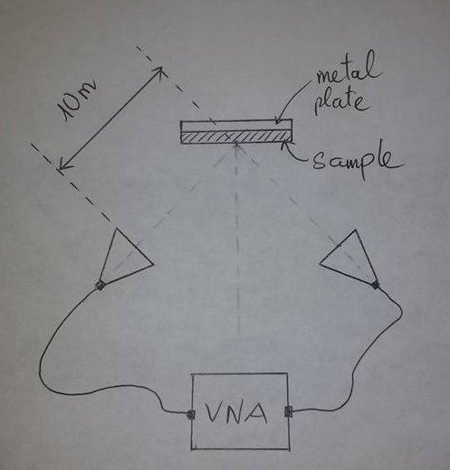
NRL Arch Prototype: Measurement Setup
VNA is used as both the stimulus and detector of microwave signals
Signal from the reflective plate (without the sample) provides a reference signal for calibration
Reflectivity in dB = 10*log10 (P1/P0)
Absorption coefficient of PVC is calculated and compared.
An arch with positioners will be built to measure reflection for different incident angles

Slide 6
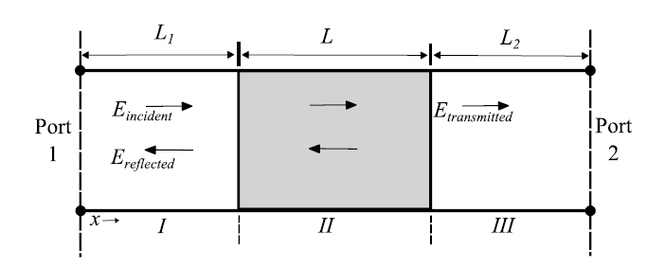
Waveguide Prototype: Measurement Setup
L: a segment of rectangular waveguide where a sample has been placed
L1, L2: hollow rectangular waveguide
Port 1 and Port 2 are connected to VNA
using adapters.
Equations for complex epsilon and mu are provided in Microwave Electronics: Measurement and Materials Characterization
L.F. Chen et al 2004,
Microwave Electronics: Measurement and
Materials Characterization

Slide 7
Procedures: Optimization
Interactive Solver: Solving both material thickness and material properties at the same time. Provide higher accuracy.
NRL Arch measurement in RF chamber
Partially filled waveguide
EM simulation: EM Pro, avaialble for students at PSU
Modeling

Slide 8
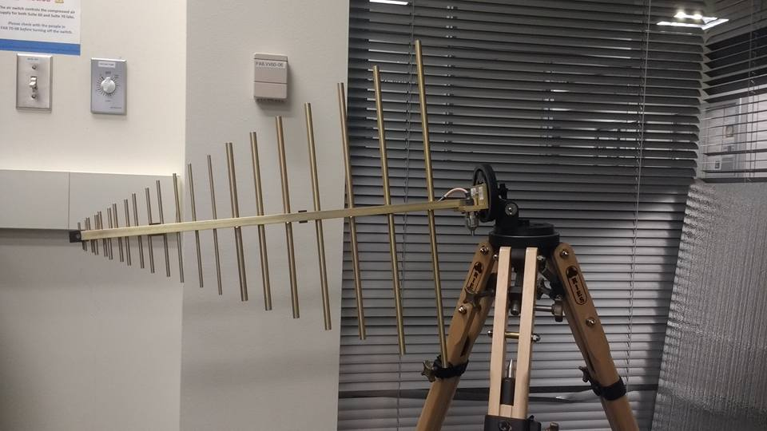
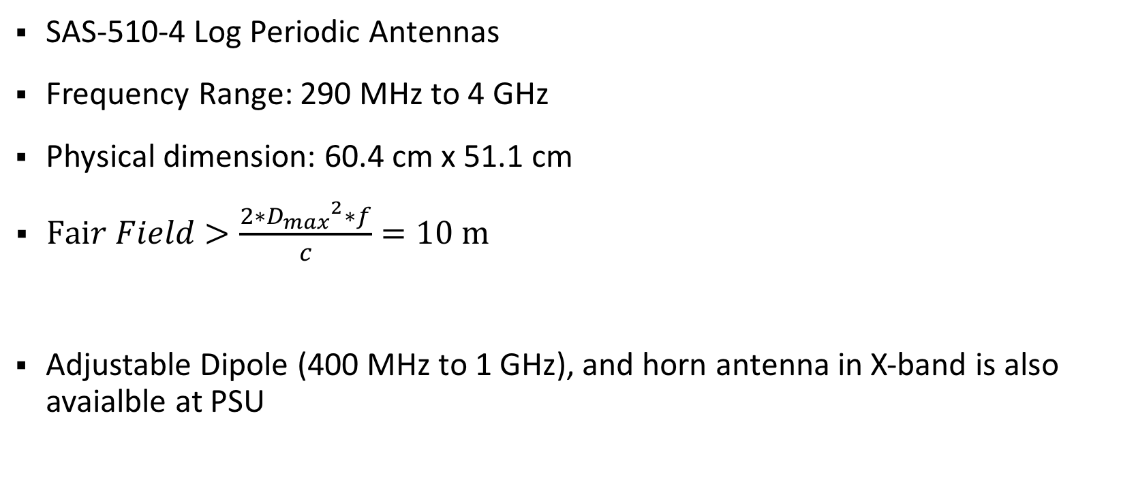
Available Parts: Antennas
SAS-510-4 Log Periodic Antennas
Frequency Range: 290 MHz to 4 GHz
Physical dimension: 60.4 cm x 51.1 cm
$Fair Field>\frac{2∗{D_{max}}^{2}∗f}{c}=10 m$
Adjustable Dipole (400 MHz to 1 GHz), and horn antenna in X-band is also avaialble at PSU

Slide 9
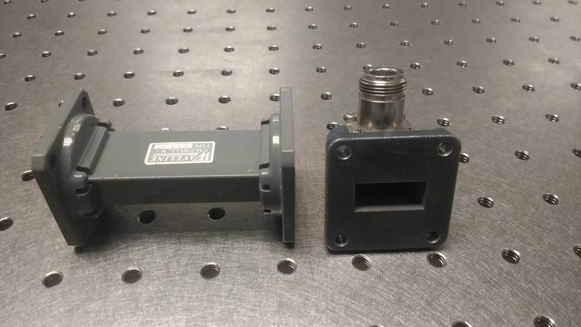
Available parts: Waveguides
PSU has waveguide and adapter in X-band (figure)
We still need to find a sample holder (a segment of X-band waveguide that has suitable size for the sample) and a TRL calibration kits
Reflect standards: A X-band waveguide short termination
Line standards: A X-band waveguide segment (90 degree long line at center frequency)

Slide 10
Potential Problems and Needs
Potential problems:
Required sample size for NRL arch measurement in low frequency will be too large.
Surrounding environment may affect the measurement for both setups
Sample preparation for waveguide measurement is not perfect and hard to detect.
Needs:
Sample with various sizes for different frequency range
Antennas for frequency range 4 – 8 Ghz and above 12 Ghz
Waveguide sample holders
Waveguide for other frequency range (except X-band)

Slide 11
Current Status
Finish detail time plan (using Gantt chart).
Finish researching and literature review.
Finish gathering parts avaialble at PSU. We need detailed information about sample size and antenna/waveguide printing capability.
Equations and measurement setup for prototype of NRL arch and waveguide are available.

Slide 12
Related Documents and References
All related documents are available on GitHub https://github.com/trankhiemha/ECE412-413-Capstone-Project-N3
Project progression tracking is available on Trello https://trello.com/b/Ov0bqGiB/initial-cf-planning
Research papers are on Zotero page: https://www.zotero.org/groups/957151/items

